Slide 1
Customer churn prediction
Data Science project to predicting customer churn for a Telco

Slide 2
Why is this important?
Predicting a customer churn before it actually happens enables our business to take corrective actions to potentially retain the customer.
From a customer standpoint, taking corrective actions to retain the customer is a positive customer experience and helps us build long-term brand value.
From a financial perspective, retaining customers help increase overall revenue and customer lifetime value metrics.

Slide 3
Data & Tools used
Data
The raw data contains 7043 rows (customers) and 21 columns (features). The “Churn” column is our target/dependent variable.
Data was obtained from IBM Watson Analytics Sample dataset website
Tools used:
Python & Jupyter Notebook

Slide 4
6-step ML Process
Import data
Data wrangling
Exploratory data analysis
Machine Learning (Model Training & Testing)
Inferencing
Conclusion/Story

Slide 5
1. Import Data
Data is imported through Python’s pandas data frame
If the size of the data is bigger, we could explore PySpark for a future iterations of this project

Slide 6
2. Data Wrangling
As a part of data wrangling, performed following steps
Removed 11 rows from the data that had missing values
Converted yes/no values into 1/0 to enable the use of these columns in ML algorithms later

Slide 7
3. Exploratory Data Analysis (EDA)
As a part of EDA, performed visual and statistical analysis for each variable.
Ran a visual
Ran a statistical inference on it’s relationship with Target variable: churn
Following slides show 5 important findings from EDA

Slide 8
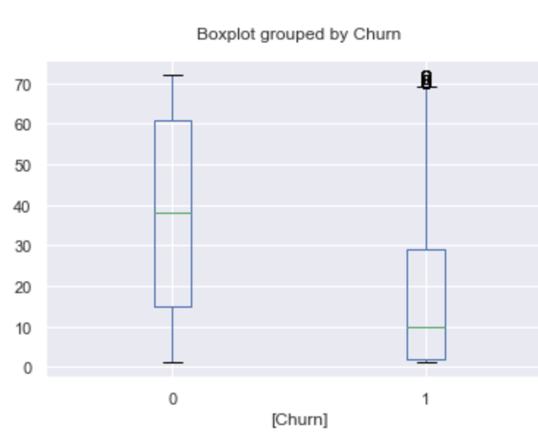
3.1. Longer tenure reduces likelihood of churn

Slide 9
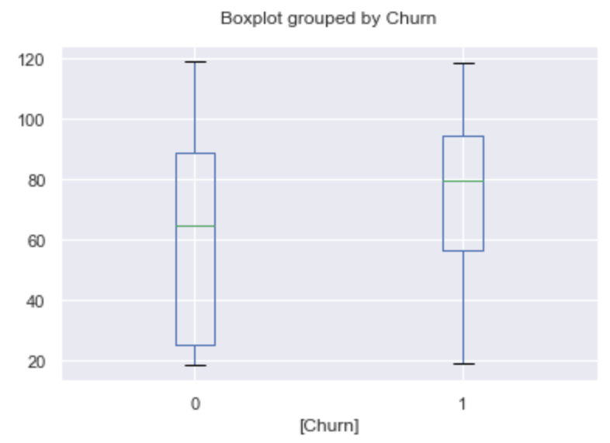
3.2 Higher monthly charges increases likelihood of churn

Slide 10
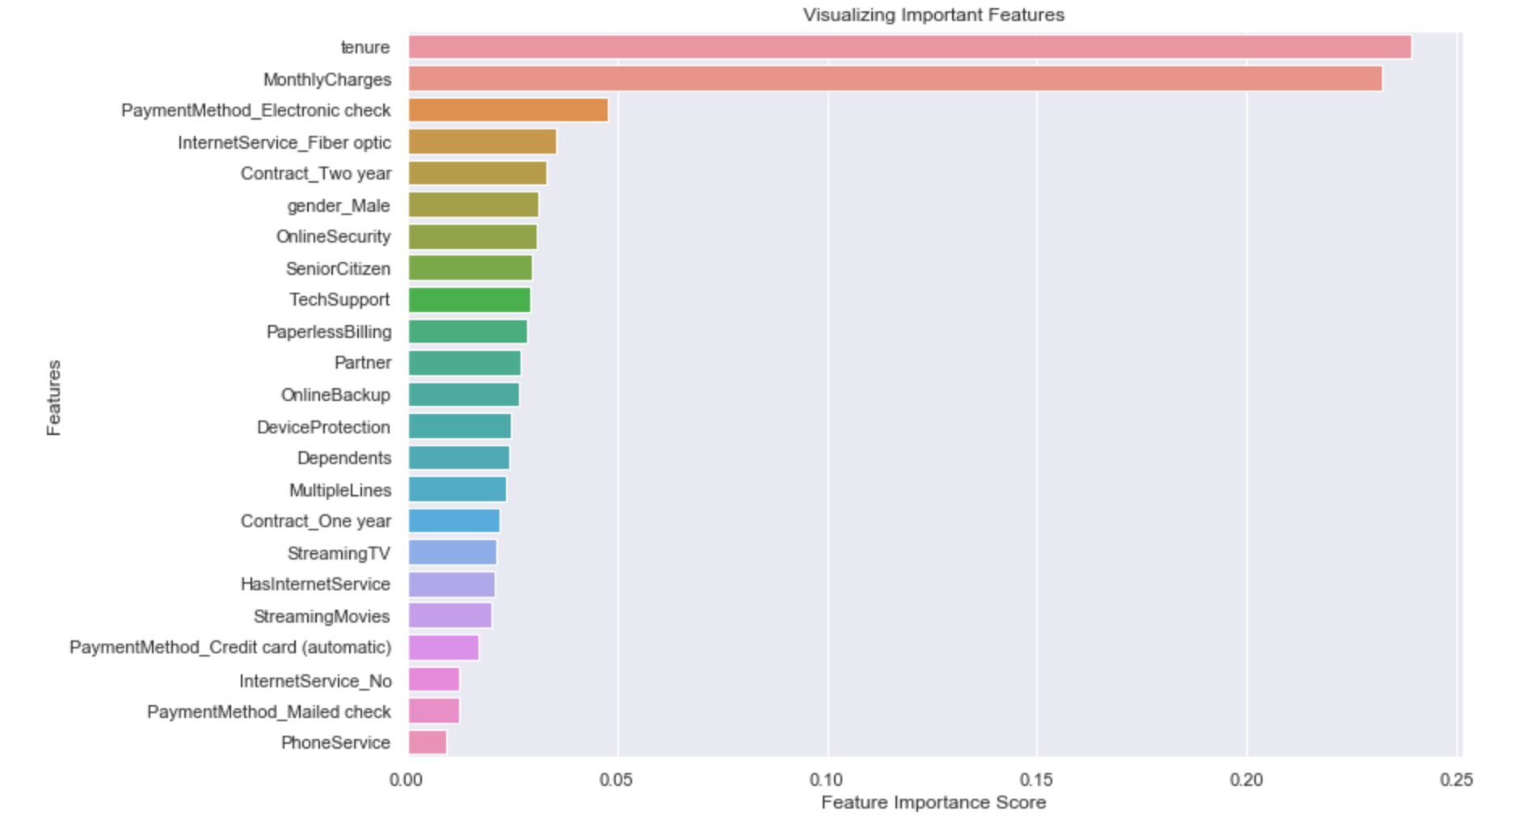
3.3 Feature Importance Score
This was part of Random Forest implementation but it’s good information as part of EDA

Slide 11
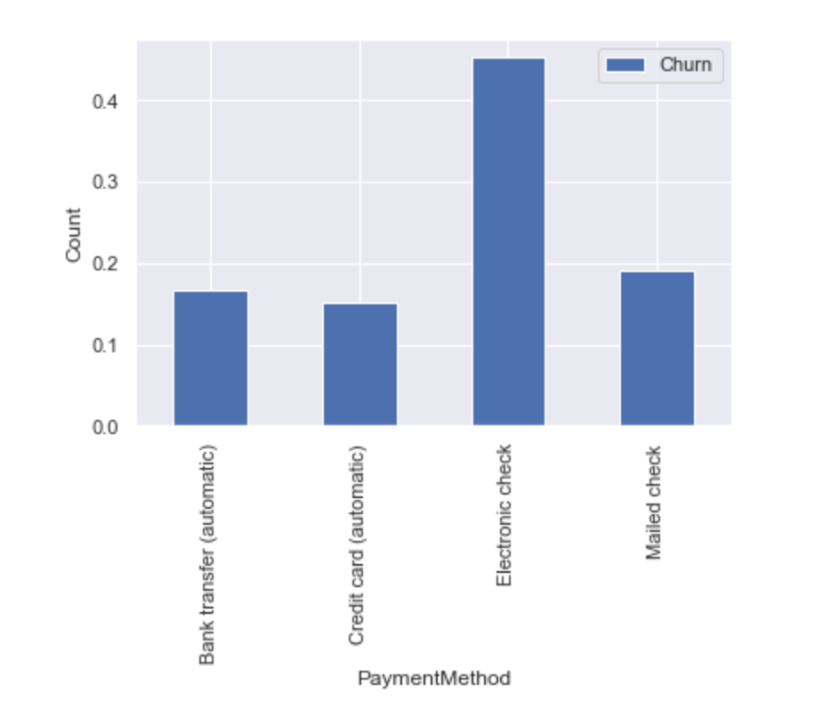
3.4 Automated payment methods decreases likelihood of churn

Slide 12
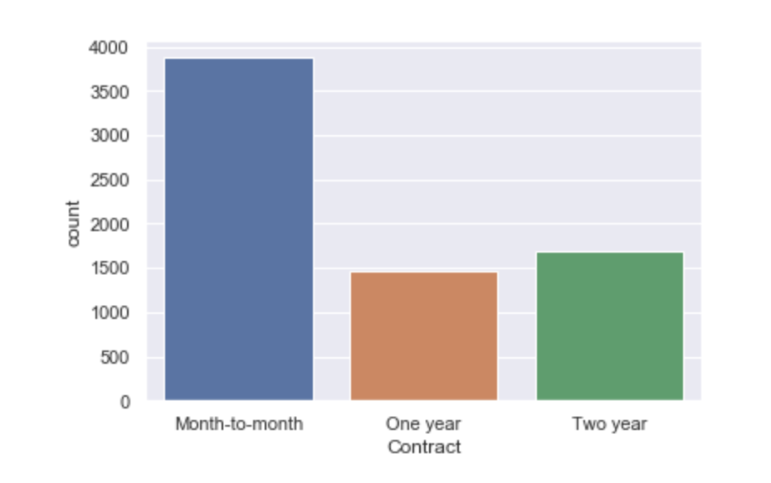
3.5 Being in contracts reduces likelihood of churn

Slide 13
4. Machine Learning (ML)
Built Train & Test sets. Also converted some features into dummy variables that was needed.
Since this is a binary classification problem, I implemented following algorithms:
Logistic regression
Decision Tree
Random Forest
Gaussian Process
XGBoost

Slide 14
5. Inferencing: criteria to pick winning model
Based on the business goal, we determined that it's very important that we identify all customers that are at-risk. As a part of this process, it will be acceptable if we target some customers that were not likely to churn but we still give them incentives.
So, false positives are acceptable but false negatives (customers who eventually churned but the model didn't identify them) are not acceptable.
With the goal of minimizing false negatives, we will identify models that have the lowest false negatives in the classification report. And since: Recall = True Positive / (True Positive + False Negative), we will use the classification report and identify models that have higher Recall but at the same time look at other metrics to ensure that the model is acceptable
Conclusion: we will pick the winning model that
Maximize recall
Acceptable Accuracy, Precision, F1 Score, AUC

Slide 15
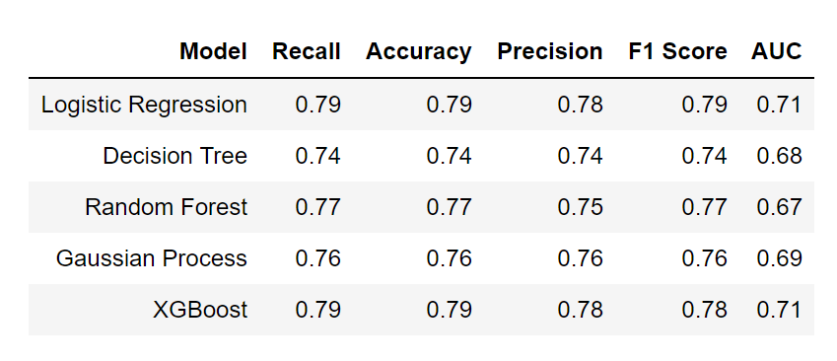
5.1 ML Performance metrics summary
Logistic regression and XGBoost have the best recall with other guard-rail metrics looking good as well. In the next slide, I show the revised performance metrics after they are tuned

Slide 16
5.2 Model Tuning
Performance metrics for tuned models:
Tuned Logistic Regression
Accuracy: 0.788
Recall: 0.79
Tuned XGBoost
Accuracy: 0.794
Recall: 0.79
Winning Model: Tuned XGBoost!

Slide 17
6. Summary
Based on the ML models applied, we can conclude that we can apply Logistic regression, decision tree, random forest, gaussian process & XGBoost for predicting customer churn. After tuning the models, we found the winning model in Tuned XGBoost.
During the process, I have learned following things about this dataset:
Tenure and Monthly Charge have the highest feature importance score. The data shows that there is a statistically significant difference in churn & tenure and also churn & monthly charge. Longer tensure reduces the probability of churn. Higher monthly charges increases the probability of churn.
Factors that are NOT statistically significant drivers of churn are Gender and Phone Service.
Factors that are statistically significant drivers of churn are Senior Citizen, Partners, Dependents, Multiple Lines, Internet Service, Online Security, Online Backup, Device protection, Tech Support, Streaming TV, Streaming Movies, Contract, Paperless billing and Payment method -- Along these lines, we can conclude things such as customers on a Month to Month contract with electronic check as payment method are more likely to churn comapred to customers that are on a one or two year contract and pay through automatic bank transfer or automatic credit card.

Slide 18
6.1 Limitations of Analysis and Dataset:
There are few limitations of the analysis and dataset that I wanted to call out:
Snapshot vs temporal/time based: The current data is snapshot based without giving us a indication the data/time when the churn occurred. This also blocks us from analyzing if there are any seasonal changes.
Service usage data: While the data has flags to indicate if the customer signed up for a service or not, it doesn't tell anything about the usage of these services. My hypothesis is that if a customer doesn't use a service then they are likely to stop the plan.
Leading indicators of bad customer experience that increases likelihood to churn: This dataset also doesn't list any leading indicators before which a churn could happen: For instance, a service outage, bad customer service call, angry emails, etc. These leading indicators would be great in predicting the churn as well.

Slide 19
6.2 What are the next steps in analysis?
The next step in the analysis is to incorporate missing features called out in "limitation" section and continue to iterate on the model.

Slide 20
Thank you!

